Slide 1
@AtlCodeCamp
https://AtlantaCodeCamp.com/2016

Slide 2




Platinum Sponsors

Slide 3







Gold Sponsors

Slide 4





SWAG Sponsors
Silver Sponsors

Slide 5
Intro to Web APIs and Postman
Tanya Do
Atlanta Code Camp 2016

Slide 6

About Me – Tanya Do
.NET Developer @
Twitter: @HeyItsTanyaDo
Blog: http://TanyaDo.com

Slide 7
Agenda
TripFiles
What are web APIs?
REST
.NET’s Web API Framework
Postman
Demo
Q & A

Slide 8


Slide 9
What are Web APIs?

Slide 10
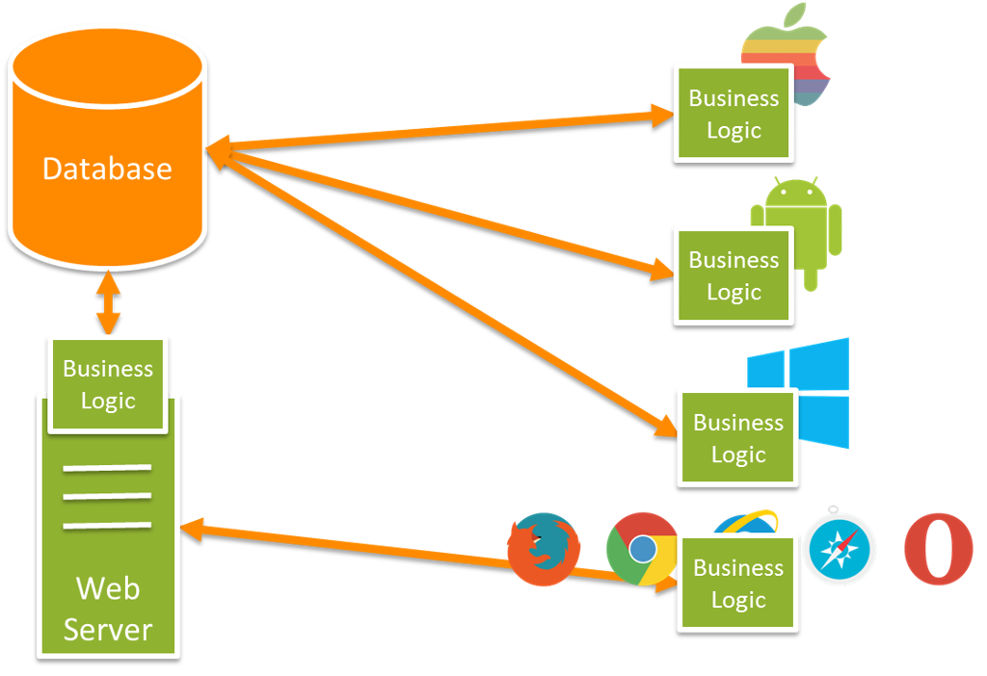

Slide 11
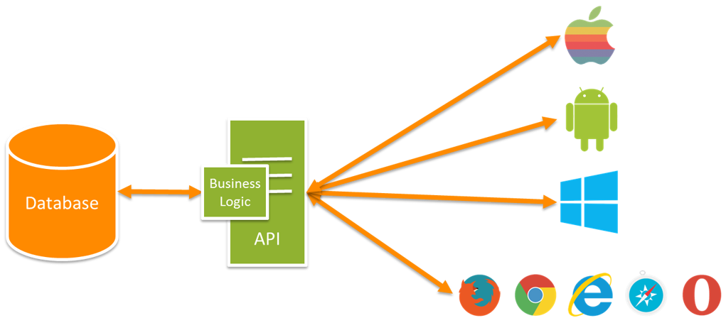
Notes:
Add another API

Slide 12
REST

Slide 13

REST is my favorite…

Slide 14
Why talk about REST?
Pretty much all APIs are Restful APIs
Architectural design pattern
REST = REpresentational State Transfer
Stateless
Representational
Built based on HTTP
Uses HTTP requests, response, verbs, status codes to communicate
CRUD verbs: (GET, POST, PUT, DELETE)
Resources vs Service
Accessing name resources (via URIs) : VERB-NOUN
GET http://example.com/path/to/resource
Notes:
Stateless (no sessions)
Representational (instead of object = light weight)

Slide 15
Benefits of REST
Nearly all clients understands HTTP
Supports different formats (JSON, XML)
Light weight
Scalable
Cache-able

Slide 16
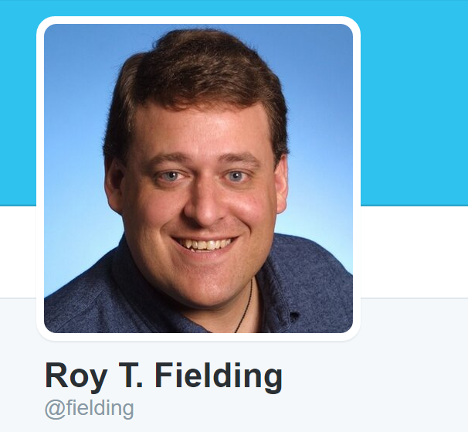
Fun Fact
Created by Roy Fielding in 2000
‘Architectural Styles and the Design of Network-based Software Architectures’
And he has a twitter account: @fielding
This is him:

Slide 17
ASP.NET’s Web API Framework

Slide 18
Web API Framework
Does heavy lifting for you
Works seamlessly with Entity Framework and MSSQL
Auto Serialization to JSON or XML
Scaffolding
Dynamic Help Pages
Routing
Default convention: http://example.com/api/{controller_name}/{id}
Or customize with route attributes

Slide 19
Postman

Slide 20


Slide 21


Slide 22
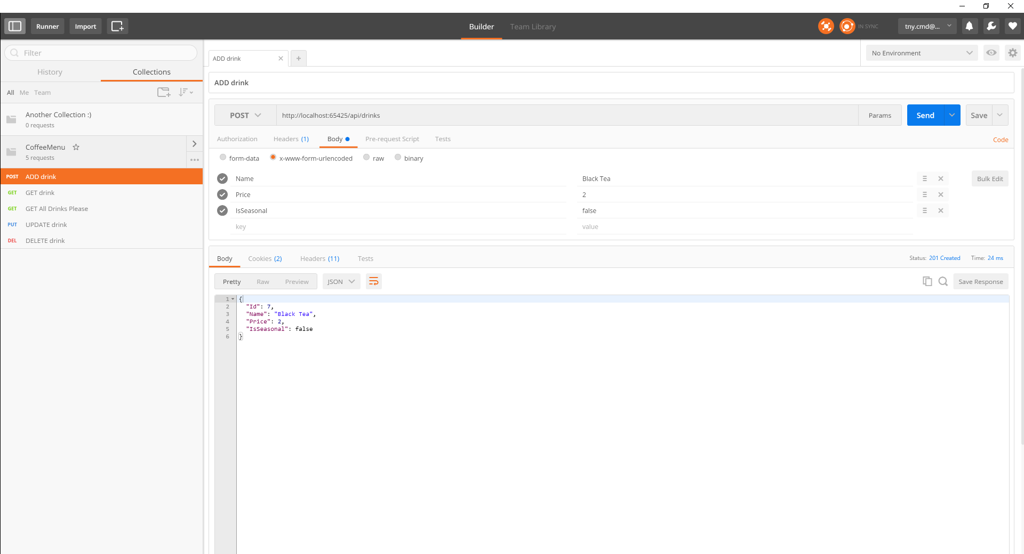

Postman is a tool

Slide 23
Let’s Build an API
Demo

Slide 24
Questions?

Slide 25
Surveys and Prizes
Please complete the session and event surveys!
1 ticket per session survey
1 ticket for the event survey
1 ticket for completing the booth game
Drawing for prizes begins at 5pm in Q202

